Slide 1
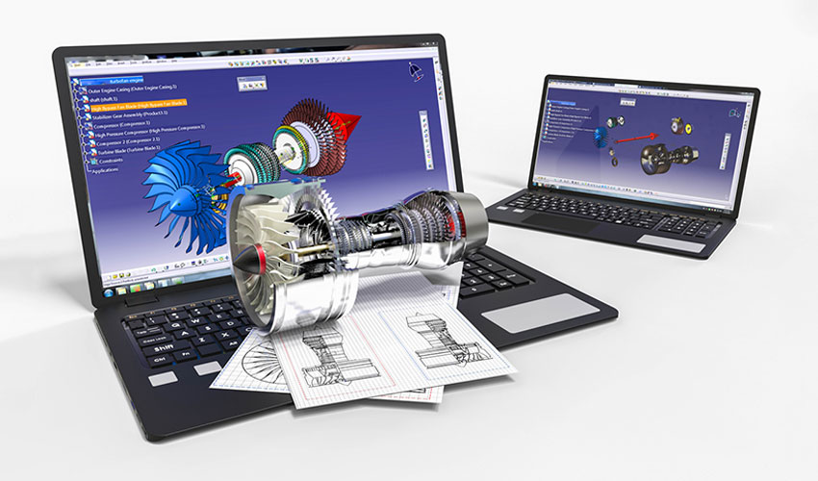
higher Design & Manufacture
CAD, CAM and CIM

Slide 2
Learning intentions & success criteria
Learning Intentions
Learning about the influences of computers on Design and Manufacturing.
Success Criteria
Explain the impact of computers on design and manufacturing.
Understand and explain: CAD, CAM and CIM

Slide 3
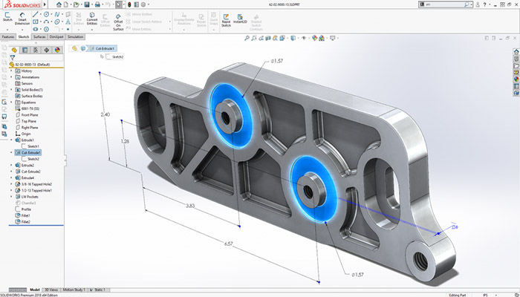
What is CAD
Computer Aided Design (CAD) is a system which allows the user to input design information.
Shapes
Forms
Materials
Sizes
Tolerances
Can all be added as design criteria.
Standard components can be stored in a library to save time.
Simulations can be performed to test behaviours, properties and to identify errors.

Slide 4
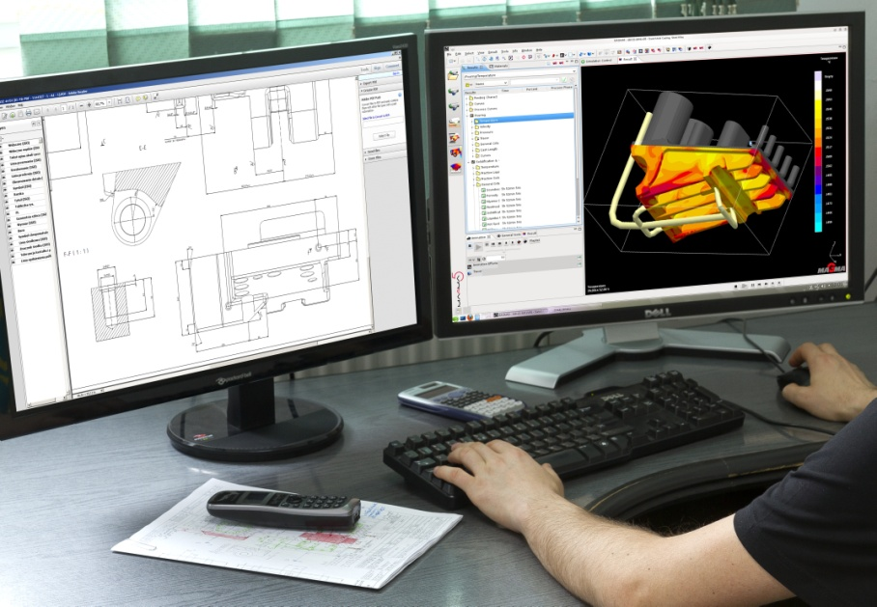
The rise of CAD
Almost all design work is carried out using CAD systems.
Whilst initial ideas may be sketched manually, CAD systems allow designs to be represented in 2D and 3D.
Even in schools, CAD systems are crucial in Craft, Design & Technology based subjects.

Slide 5
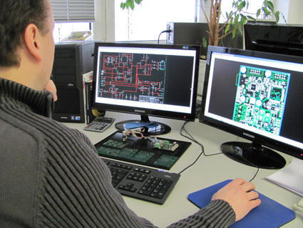
Advantages of CAD
Development time is reduced drastically.
Quality and accuracy of design work is increased.
Improvements are easily identified and quickly implemented.
Data is easily stored, retrieved and shared.
Design work is better integrated in to manufacturing systems.

Slide 6
Disadvantages of Cad
Initial setup costs are high and software is expensive.
Software must be updated regularly.
Staff require training which is costly.
Difficult to manage intellectual property rights when information is stored centrally.

Slide 7
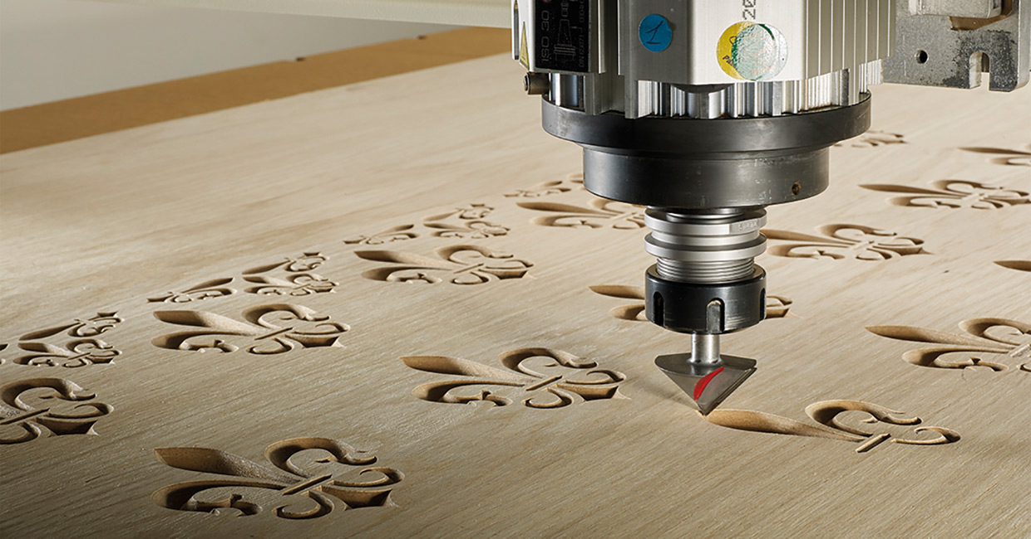
What is cam?
Computer Aided Manufacture or CAM is a manufacturing system where machinery and equipment is controlled by computer.
The use of computers in manufacturing with Computer Numerical Control (CNC) systems in the 1960s.
CNC systems used complex numerical commands to manage machinery and tooling.
However, the setup cost was very high.
CNC video-
https://www.youtube.com/watch?v=lEyNWtM6MW4

Slide 8
Evolution of cam
Now it is possible for even the smallest manufacturers to use CAM systems.
High powered computers are widely available at affordable prices and electronic/cloud storage means instructions/commands can be programmed quicker.
Designs and modifications can be implemented more quickly and the design process is more responsive to consumer needs.

Slide 9
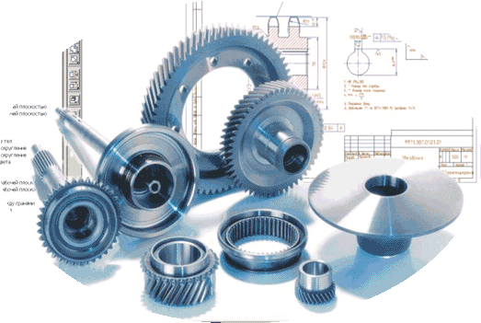
Evolution of cam
Machine Program Input
CAD System
Computer (Controller)
Machine Tool(s)
The computer has the ability to accept information from different sources to control more than one tool at once.
Detailed working drawing(s)
Production Output

Slide 10
Advantages of cam
The reliability of CAM systems result in higher productivity and therefore lower costs.
Eliminates and limits human error.
Programs can be easily updated and modified.
Complex operations can be carried out easily.
Once programs are operational, highly skilled operators are no longer required.

Slide 11
Disadvantages of cam
Installation and start-up costs can be high.
Skilled technicians are required for maintenance, resulting in high training costs.

Slide 12
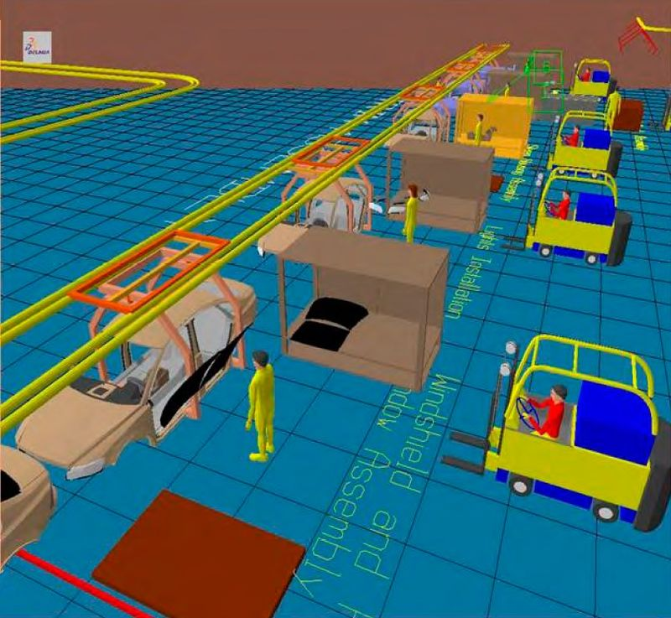
Cim- computer integrated manufacturing
Modern manufacturing uses computer technology to organise and control the entire production processes.
CAD and CAM systems form part of Computer Integrated Manufacturing system.
In CIM systems, a number of aspects can be monitored including…
Design Development
Production Scheduling
Machine Operations
Assembly and Packaging

Slide 13
computer integrated manufacturing
In a CIM system, the software on the central computer manages the system.
All computers can perform individually but also interact with the system.
Remote Manufacture
Network Systems
CIM Database
Product Research
Costing
Marketing
Product Information
Sales
Production Planning
Material Handling
Production Control
Stock Inventory
Quality Control Data
Design
Analysis
Modelling
Material Data
Manufacturing
Process Planning
CNC Machine Control
Robotic Control

Slide 14
Advantages of cim
All data and information can be exchanged quickly via computers and networks.
The overall time to develop and manufacture products is vastly reduced.
The quality and reliability of products has been increased significantly.
Savings in time, materials and labour result in cost savings for the consumer.

Slide 15
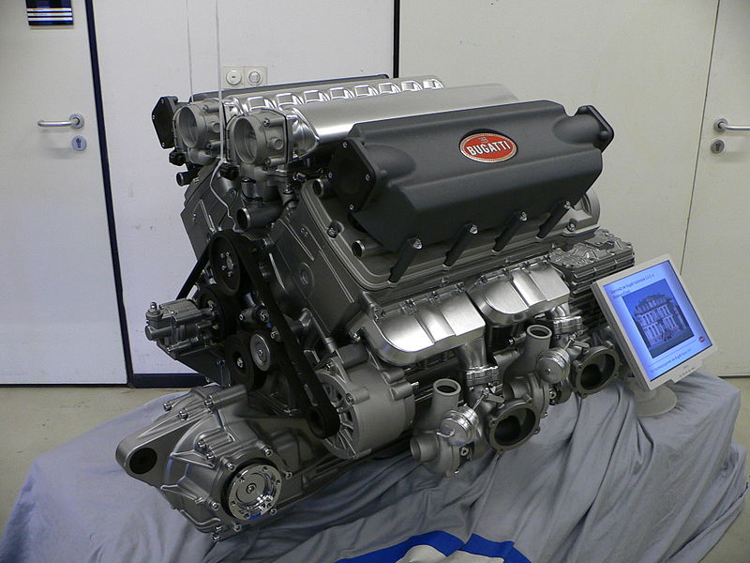
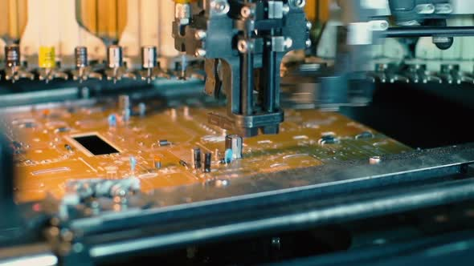
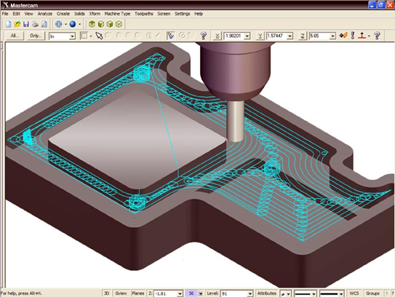
Use of cim
CIM systems are now crucial due to the demand for technologically advanced subjects.
CIM systems have allowed the storing, sharing and translation of information to be instantaneous.

Slide 16
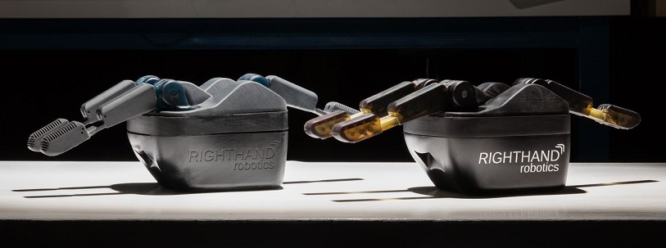
Rapid Prototyping
Rapid prototyping is a CAD/CAM process that generates a 3D model instantly from a Computer aided drawing.
Advantages include-
Reasonably fast to produce a prototype.
The prototype can be made from the actual material the product is made from.
The level of accuracy is extremely high.
Moving parts can be created (Unlike models).
Models can be adapted and reproduced quickly.
The client can see the product as a high quality prototype.

Slide 17
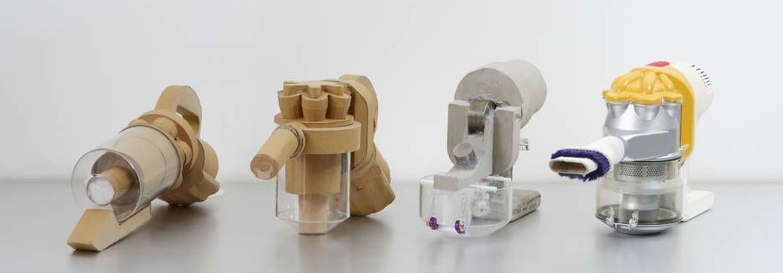
Rapid Prototyping
Disadvantages include-
Added initial costs.
Some rapid prototyping processes are still expensive and not economical.
Requires skilled labour.
Overlooking key features that can not be prototyped.
End user confusion, customers mistaking it for the finished product.

Slide 18
Disadvantages include-
Added initial costs.
Some rapid prototyping processes are still expensive and not economical.
Requires skilled labour.
Overlooking key features that can not be prototyped.
End user confusion, customers mistaking it for the finished product.
Rapid Prototyping

Slide 19
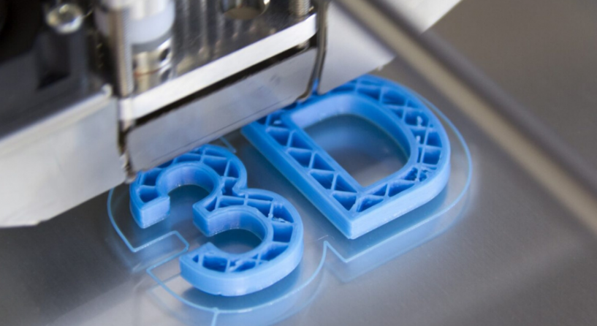
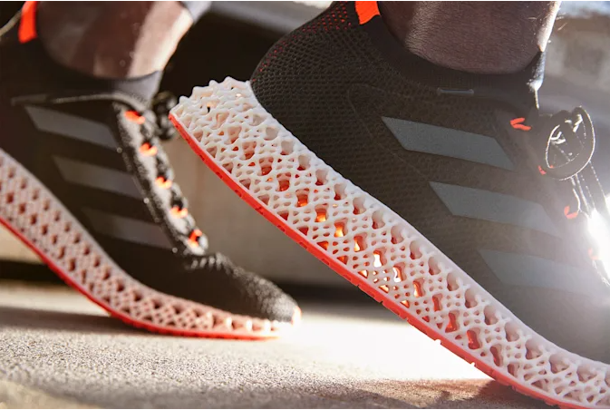
3d printing
3D printing is becoming more affordable and popular as a manufacturing technique.
Advantages include-
Flexible designs
Rapid prototyping
Print on demand
Strong and lightweight parts
Minimises waste
Cost effective
Ease of access
Environmentally friendly (reduces material waste/recyclable waste)

Slide 20
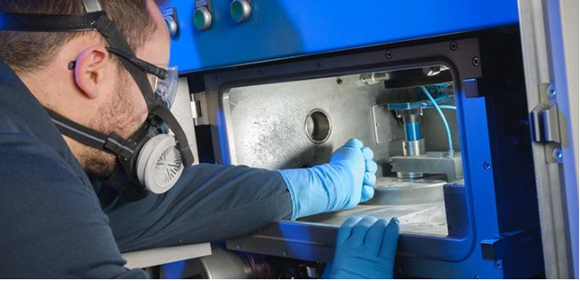
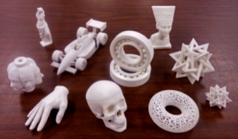
3d printing
Disadvantages include-
Limited materials can be used
Restricted build size
Large volumes are not as cost effective
Design inaccuracies
Copy right issues

Slide 21
Higher past paper question
Explain the benefits of using computerised systems in the design and manufacture of modern products.
(4 marks)

